Slide 1
CS2106 Tutorial 5
Synchronisation

Slide 2
Q3a
We need to find a scenario of interleaving where it fails and has undefined behaviour

Slide 3

Mutex recap

Slide 4
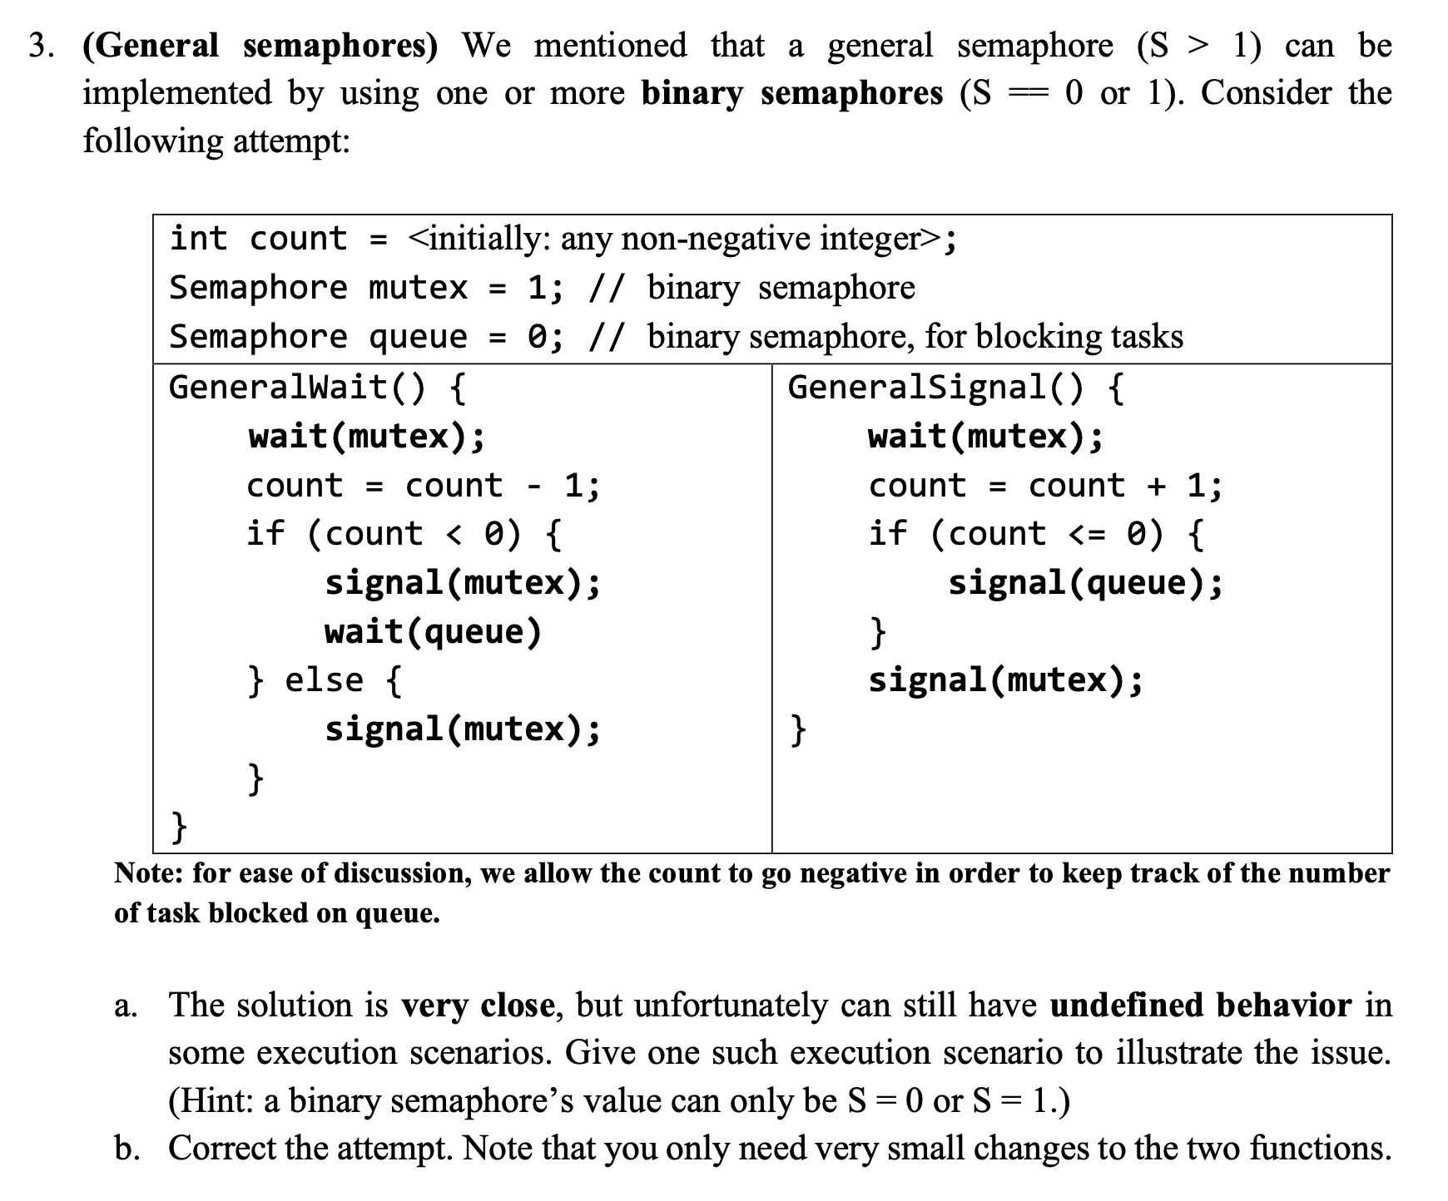
There are 3 kinds of objects here
1. A binary semaphore named mutex
2. A binary semaphore named queue
3. A integer variable named count
Think about their values during the execution described on the following slides
Let’s now consider process A and B

Slide 5


Slide 7


Slide 8
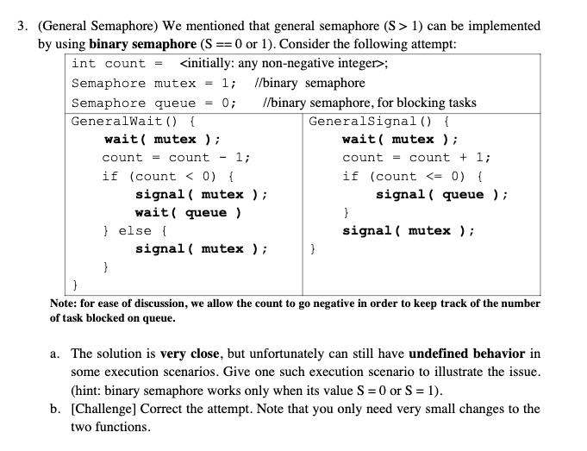
Following Process A and B’s execution, mutex value will be 1. But the value of the integer variable count will be -2 because A and B decrement it once each.
See previous three slides.
Since the mutex value is one so either C or D (not both) can be in mutex’s critical section. Consider C and D entering mutex’s critical section one after the other. But A and B do not execute while this is happening.
More specifically:
When process C is executing GeneralSignal() within the mutex’s critical section, it increments count once to -1. So the if branch runs and signal(queue) is done once.
Note that here process A and B need not run immediately. We are going to assume that they do not run for this execution
2. When process D is executing GeneralSignal() within the mutex’s critical section, it increments count once to 0. So the if branch runs and signal(queue) is done for the second time.
When a mutex (binary semaphore) is signalled twice, its value goes above 1 and has unpredictable behaviour.

Slide 9
Q3b
How do we fix this? Let’s first define the objectives we want to fulfil

Slide 10


Implement general with binary
FIX: Need to ensure signal is not done twice on a binary semaphore
Processes can enter up to a number N
N+1 ^{th} Process and the following need to be blocked
We can use an integer to count the processes in C.S. (Critical Section)
Remember to use a binary semaphore to protect access to this integer count
To prevent race conditions when accessing value
General wait
General signal

Slide 11




Implement general with binary
FIX: Need to ensure signal is not done twice on a binary semaphore
Processes can enter up to a number N
N+1 ^{th} Process and the following need to be blocked
We can use an integer to count the processes in C.S. (Critical Section)
Remember to use a binary semaphore to protect access to this integer count
To prevent race conditions when accessing value
General wait
General signal

Slide 12


Implement general with binary
FIX: Need to ensure signal is not done twice on a binary semaphore
Processes can enter up to a number N
N+1 ^{th} Process and the following need to be blocked
We can use an integer to count the processes in C.S. (Critical Section)
Remember to use a binary semaphore to protect access to this integer count
To prevent race conditions when accessing value
General wait
General signal

Slide 13
Let’s simplify the flows
But first, is there a problem?
General wait
General signal

Slide 14
Let’s simplify the flows
But first, is there a problem?
General wait
General signal
Process may wait at queue but did not release mutex. we have to release mutex before we block at queue

Slide 15
Let’s simplify the flows
But first, is there a problem?
General wait
General signal

Slide 16


Let’s simplify the flows
But first, is there a problem?
General wait
General signal

Slide 17
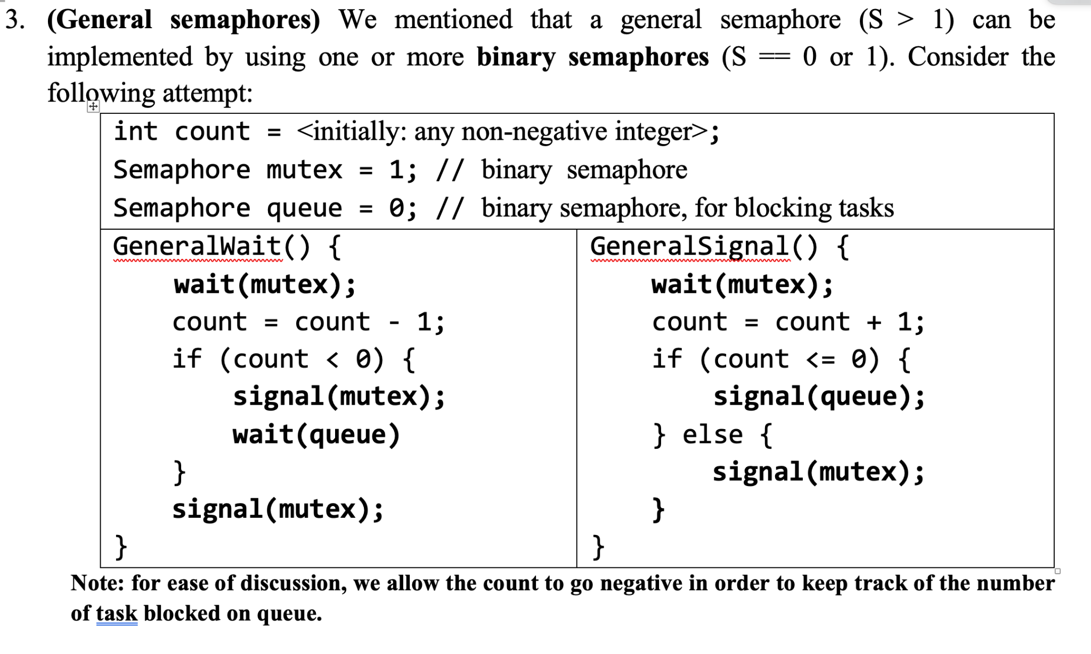





Slide 18
Q1
Race condition

Slide 19
When does the first print msg happen?
Shared variable i reaches positive 10 (then A prints) or i reaches negative 10 (then B prints)
Look at the while loop condition. When i is between -9 to 9, both tasks will keep running as their while loop condition is satisfied.
As we have seen earlier tutorials on scheduling, we can’t predict or guarantee the order of i++ or i– operations. So we can’t determine which task will print its message first

Slide 20
What happens after one task prints?
After a task exits while loop and prints its msg
Only one task is accessing shared variable i
It will continuously increase / decrease the value of i till while loop condition is not satisfied
Then it will print its msg and finish

Slide 21
What if A starts first
No guarantees again
But is could be possible if A reaches 10 before B starts

Slide 22
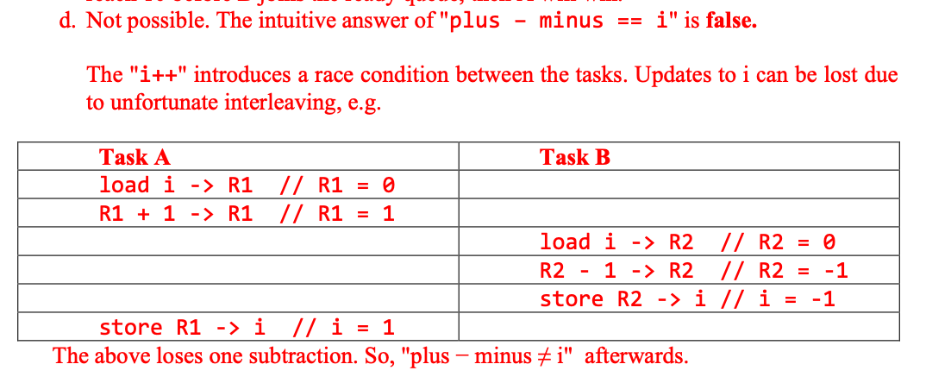
i != plus - minus

Slide 23
Q2
RW problem

Slide 24
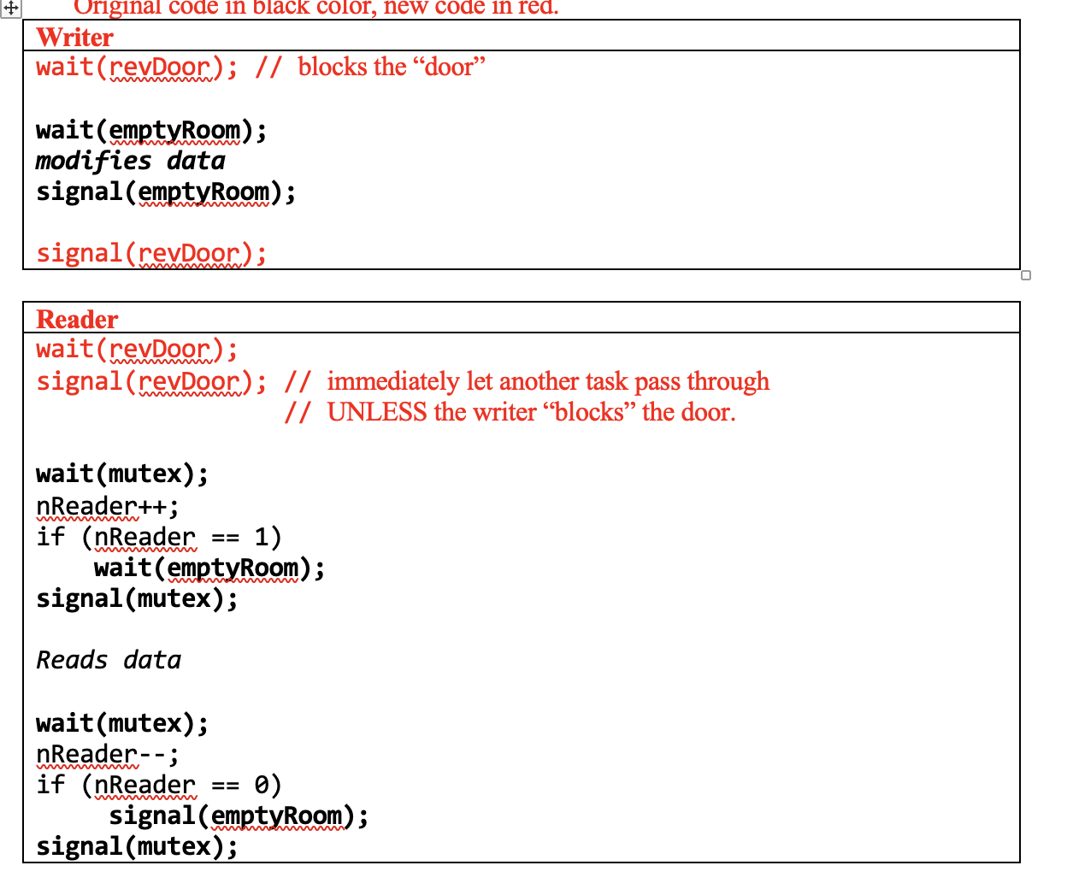

Slide 25



Mutex as a revolving door
Effect of wait and signal that are back to back for a single process
wait will decrement mutex value to 0 and it will enter empty C.S.
Then it will signal, exit empty C.S and increment mutex value to 1
Effect for two processes reaching empty C.S

Slide 26


Mutex as a revolving door
Effect of wait and signal when one process has non-empty critical section
Note that they wait on the same mutex
writer B will wait for empty room
all present readers in the room will eventually leave
writer B enters the room, block the door and does its writing

Slide 27
Mutex as a revolving door
Effect of wait and signal when one process has non-empty critical section
Note that they wait on the same mutex
writer B will wait for empty room
all present readers in the room will eventually leave
writer B enters the room, block the door and does its writing
when writer is done, it will signal

Slide 28
Q4
Dining Philosophers

Slide 29





Dining Philosophers recap
Five philosophers are seated around a table
There are five single chopstick placed between each pair of philosopher
When any philosopher wants to eat, he/she will have to acquire both chopsticks from his/her left and right
Devise a deadlock-free and starve-free way to allow the philosopher to eat freely

Slide 30







To argue consider one person (R hander)
There are three cases that can happen for the Right Hander
Consider all cases and show that in deadlock can’t happen in any of the cases
Case 1:
John grabs right then grabs left
-> John gets to eat
Case 2:
John grabs right, but left is already grabbed by Peter
-> Peter eating
Case 3:
John cannot grab right

Slide 31









To argue consider one person (R hander)
There are three cases that can happen for the Right Hander
Consider all cases and show that in deadlock can’t happen in any of the cases
Case 3:
John cannot grab right
Case 3a:
Tom can grab right -> Tom eats
Case 3b:
Tom cannot grab right

Slide 32
To argue consider one person (R hander)
There are three cases that can happen for the Right Hander
Consider all cases and show that in deadlock can’t happen in any of the cases
Case 3:
John cannot grab right
Case 3a:
Tom can grab right -> Tom eats
Case 3b:
Tom cannot grab right
in the worst case where 3a never happen for process a-d, it will eventually reach peter. peter can grab right as john cant grab left without right

Slide 33
Q5
Using a pipe as a mutex

Slide 34
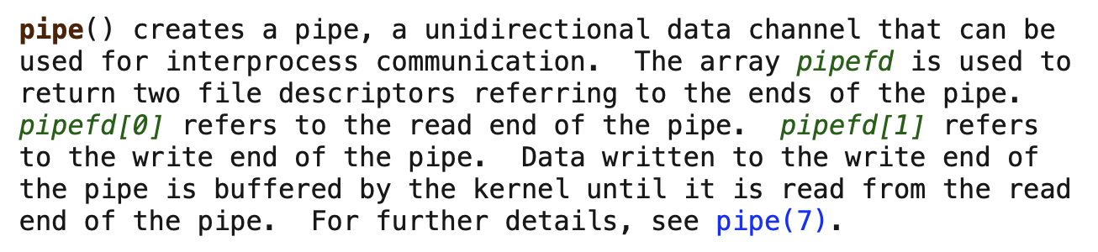
Pipe recap

Slide 35
Comparison
MUTEX
PIPE
Enters C.S when mutex value is 1
Decrements mutex value after entering C.S
Blocks if mutex value is 0
Increments mutex value to 1 when it exits C.S
Readers do not block when pipe has data
Readers decrement remaining bytes of data in pipe upon reading from it
Readers block if there is no data in pipe
Writers increment remaining bytes of data in pipe when writing to it

Slide 36
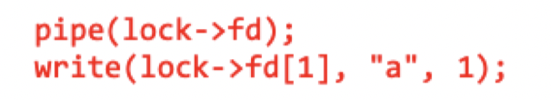
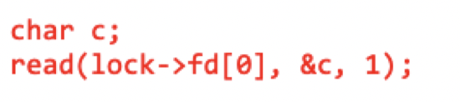
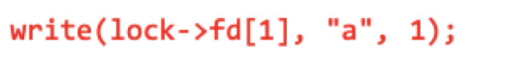

Comparison
MUTEX
PIPE
Enters C.S when mutex value is 1
Decrements mutex value after entering C.S
Blocks if mutex value is 0
Increments mutex value to 1 when it exits C.S
Readers do not block when pipe has data
Readers decrement remaining bytes of data in pipe upon reading from it
Readers block if there is no data in pipe
Writers increment remaining bytes of data in pipe when writing to it

Slide 37
Q6
Optional – One Time Barrier

Slide 38
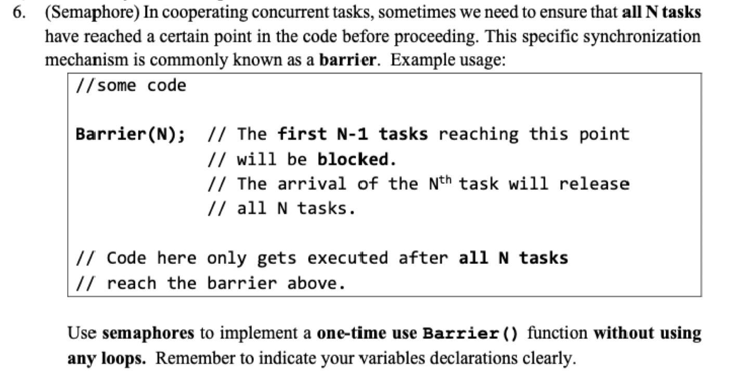

Slide 39
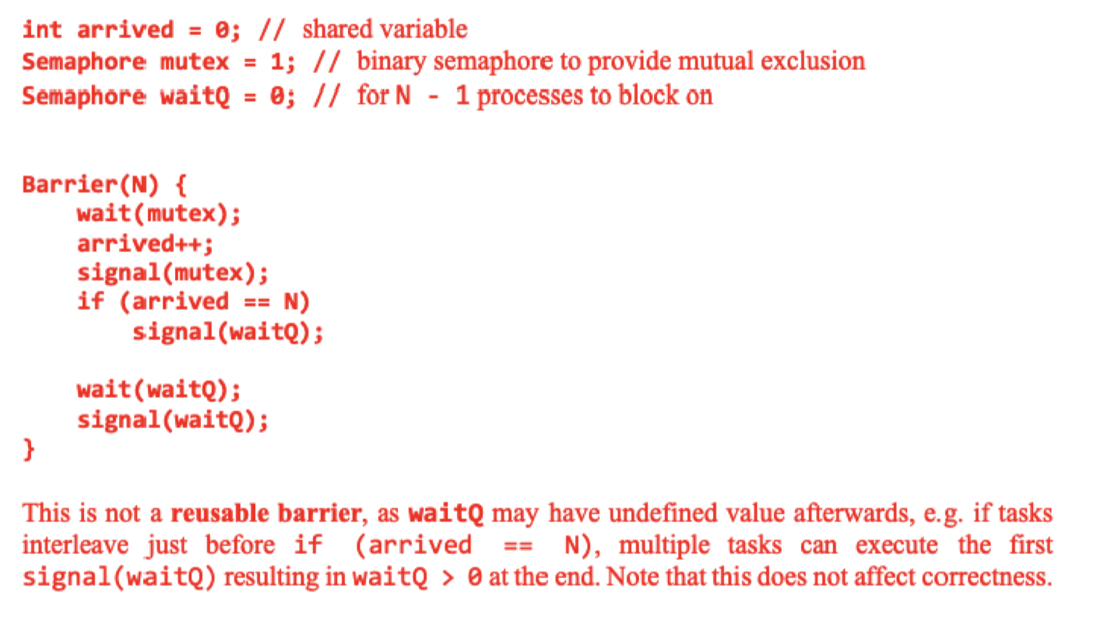
Reusable barrier?
Look for the answer in Little Book of Semaphore :>

Slide 40
Q7
Optional – Interleave pattern

Slide 41
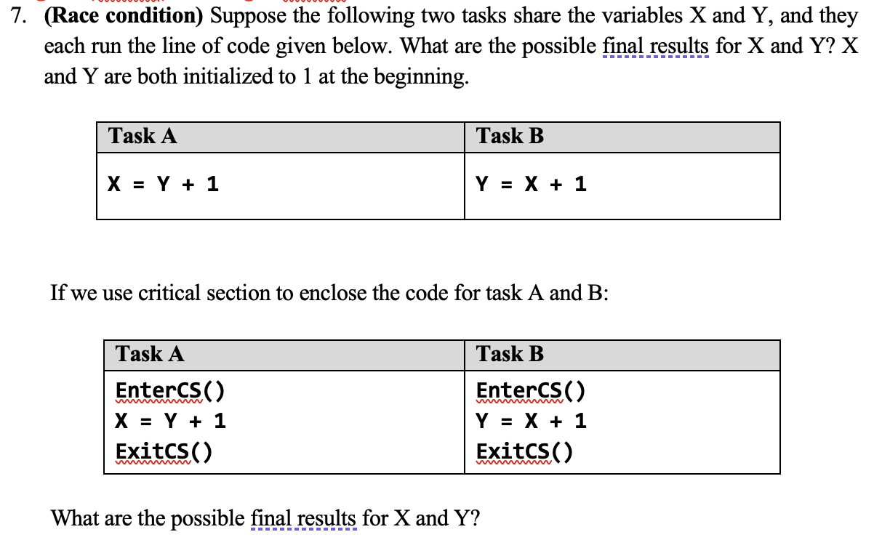

Slide 42
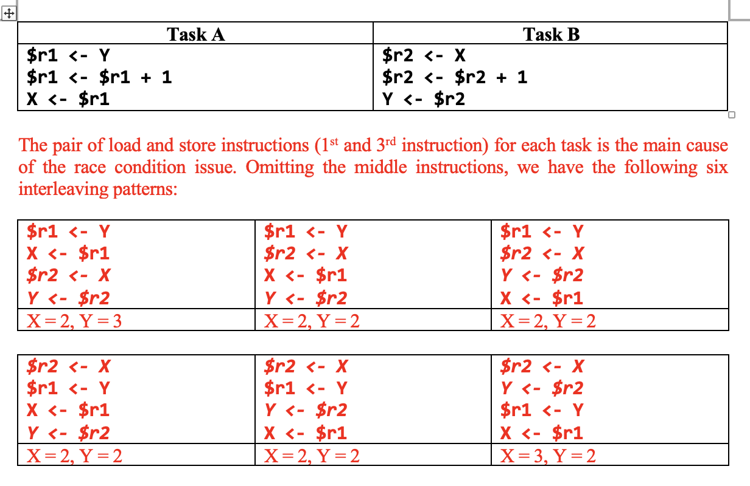

Slide 43
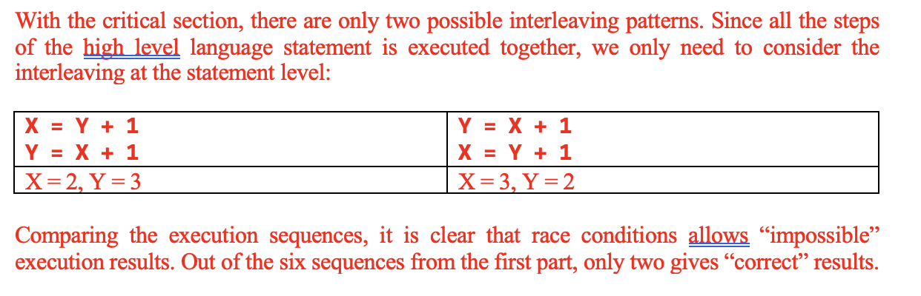

Slide 44
Q8
Optional – Other synchronization mechanism

Slide 45
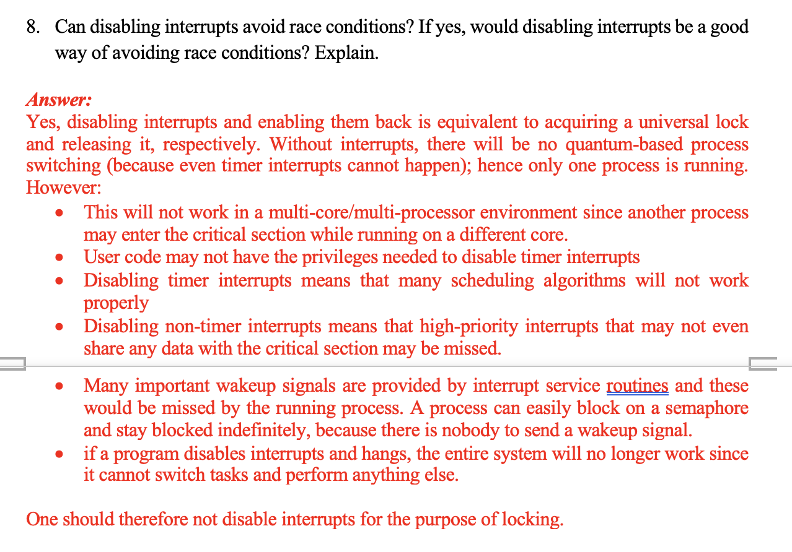

Slide 46
Thank you!
All the best for your midterm tomorrow!
Any question can drop a tele message @yifandonlyif

